Slide 1
Development of safe and highly efficient dynamic module in SAE level 5 automated driving system
Doctoral Thesis
Aachen, 30. July 2018
Minglu Li, M.Sc.
Institute for Automotive Engineering

Slide 2
Agenda
Curriculum Vitae
Background
Development of safe and highly efficient dynamic module
Research Approach
Work Progress
Outlook
Financing

Slide 3
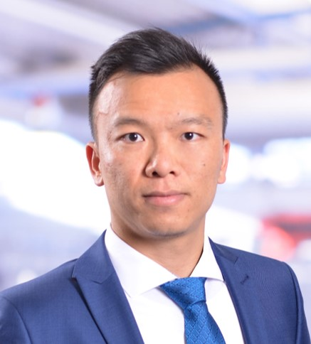

Electronics Department Li, Minglu
Profile - Overview
Li, Minglu
M.Sc. RWTH Aachen University
2018 – today Research Assistant Institute for Automotive Engineering (ika) of RWTH Aachen
2016 – 2018 Research Assistant Forschungsgesellschaft Kraftfahrwesen mbH Aachen
2014 – 2016 Masters Degree in Electrical Engineering, M.Sc. RWTH Aachen University
2009 – 2013 Bachelor Degree in Electrical Engineering, B.Sc.
Beijing University of Posts and Telecommunications
Research Assistant
Hardware Development
Battery Management System
Power Electronics & Inverter
Visual Programming Software Development & LabVIEW
Embedded Software Development
UNICARagil, German Government funded, electronics and mechatronics
SpeedE Projekt, gerneric research platform of ika
Functional design for the Surf & Curve Mock-Up CES2018 by Body Control System
Various projects with industrial partners

Slide 4
Electronics Department Li, Minglu
Profile - Resume
Li, Minglu
M.Sc. RWTH Aachen University
Minglu Li is a Research Engineer at the Institute for Automotive Engineering (ika) RWTH Aachen University and works in hardware development for power electronics, autonomous driving and e-mobility.
Minglu Li received his master’s degree in Electrical Engineering from RWTH Aachen University in 2016 and began his career as Research Assistant directly in fka – Forschungsgesellschaft Kraftfahrwesen mbH Aachen. Since spring of 2018 he joined ika as a Research Assistant.
He is an expert in the fields of functional design of hardware development, as well as inverter design in 12V and 48V power net for automotive engineering.
Research Assistant

Slide 5
Agenda
Curriculum Vitae
Background
Development of safe and highly efficient dynamic module
Research Approach
Work Progress
Outlook
Financing

Slide 6
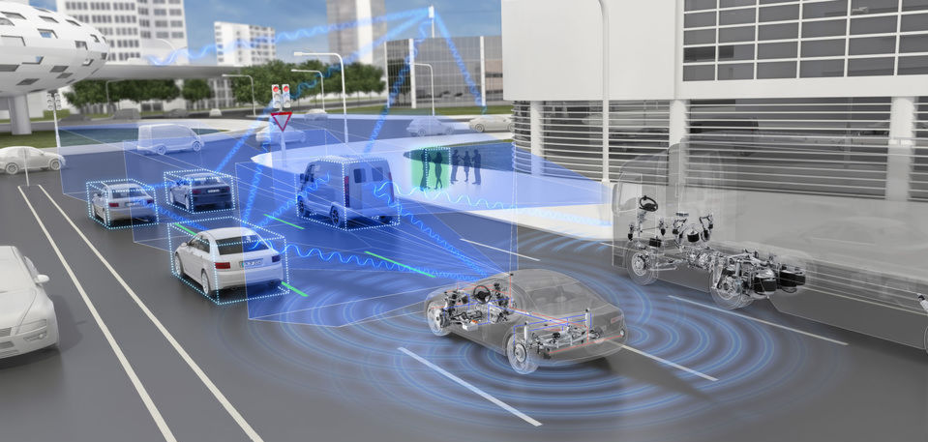
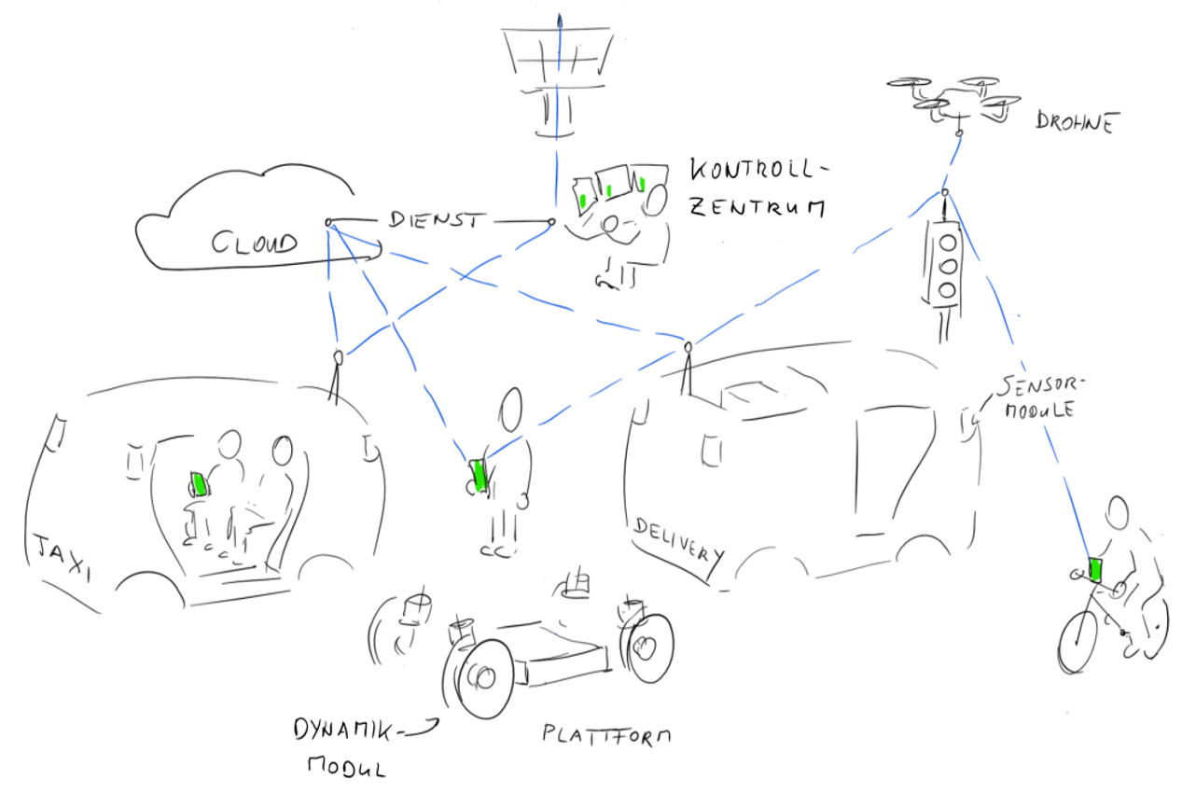
Dynamic module in UNICARagil Background
Dynamic Module in UNICARagil
Status: Highly assisted driving functionalities with intelligent, safety relevant electric actuators (driver as fall-back)
Trend: Electronic Vehicle and highly automated driving → Steer-by-Wire highly automated EVs
Challenge: Safety is the biggest topic in automated driving system, functional safety shall be standardized and data security shall be taken in consideration in the future. At the same time energy saving can compensate the shorts of battery technology. Example project: Dynamic module in UNICARagil.
Issues: Safety and efficiency topics should be included in development of dynamic module, furthermore dynamic module shall be standardized with ISO 26262
Source: ZF
Source: UNICARagil

Slide 7
Agenda
Curriculum Vitae
Background
Development of safe and highly efficient dynamic module
Research Approach
Work Progress
Outlook
Financing

Slide 8
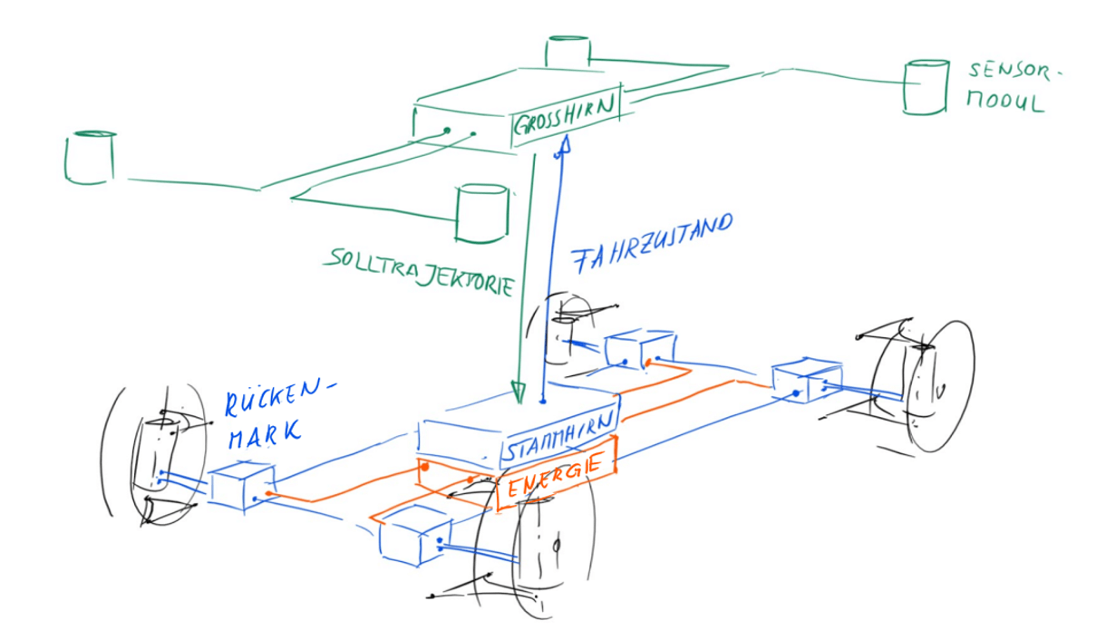
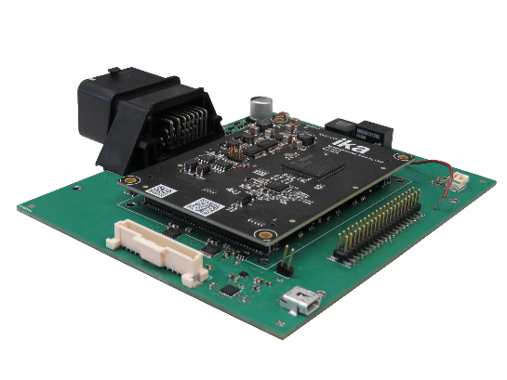
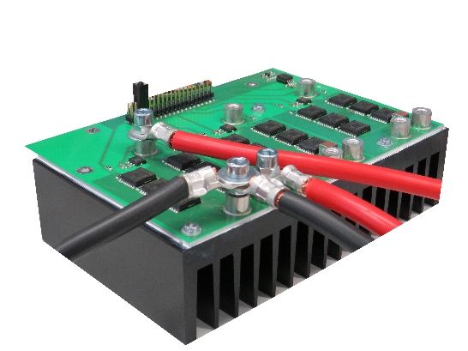
Development safe and highly efficient Dynamic Module Architecture
Safe and highly efficient intelligent dynamic module
Architecture of UNICARagil
Architecture of function
E / E Functions
Drive
Security
Bus Systems
M
Steering
Safety
Control Unit
M
Source: UNICARagil
Efficiency
E / E Architecture for Dynamic Module
Safety Unit
Safe and highly efficient
intelligent dynamic module
Control Board
Inverter Board
Function Board
Cooling

Slide 9
Development safe and highly efficient Dynamic Module Requirement
Safe and efficient Dynamic Module
Functional Safety in E / E function
Fail-operational
Additional Safety Unit
Data security
Data among dynamic modules
Data between dynamic module and “Stammhirn” and “Großhirn”
Inside of Microprocessor
High efficiency / Energy saving
Inside of dynamic module
During Drive and steering motor controlling
With optimization of cooling controlling
E / E Functions
Drive
Security
Bus Systems
M
Steering
Safety
Control Unit
M
Efficiency
Safety Unit
Safe and highly efficient
intelligent dynamic module
The entire system shall be standardized!

Slide 10
Agenda
Curriculum Vitae
Background
Development of safe and highly efficient dynamic module
Research Approach
Work Progress
Outlook
Financing

Slide 11

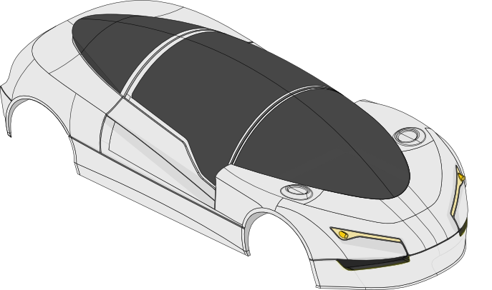


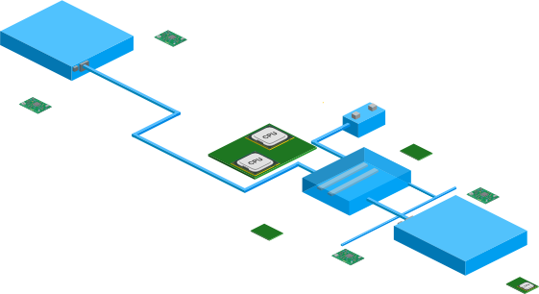




Research Approach Monitoring and Prediction
Safety and Efficiency
Safety
Efficiency
Error / Fault detection
Prediction in safety
Combine with ultrahigh frequency monitoring
Prediction in efficiency part
Driving surroundings
Dynamic system updating to match the surrounding
Ultrahigh frequency monitoring
Power consumption monitoring
Monitoring
Prediction

Slide 12
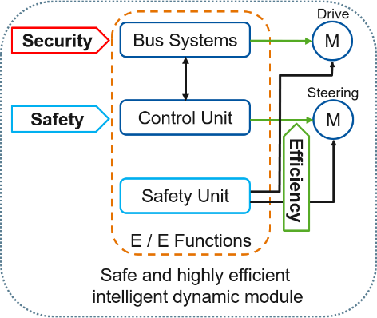
Research Approach Functional Safety and Redundancy
Safe and efficient Dynamic Module
Increasing Hardware redundancy
ASIL D MCU + ASIL B-D peripherals
Whole system in ASIL B/C level
FMEDA in system level as well in component level
Add additional safety element, i.e. PGA
Increasing Software redundancy
Prepared SW functions for future failure situations, i.e. scene analysis
Direct access and actions in failure situation
Failure
Systematic failure
Random failure
Systematic failure will be avoided during system design
Increasing redundancy = decreasing random failure
Drive
M
Sensor test
System test
Steering
Plausibility test
Redundancy test
Validity test
M
Safety Unit
Sensor fault
System fault
Source: SpeedE ika

Slide 13
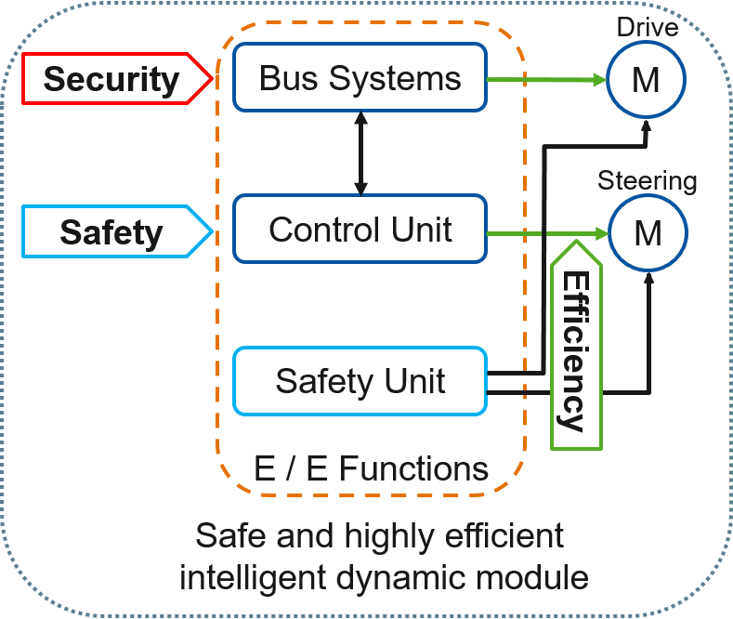

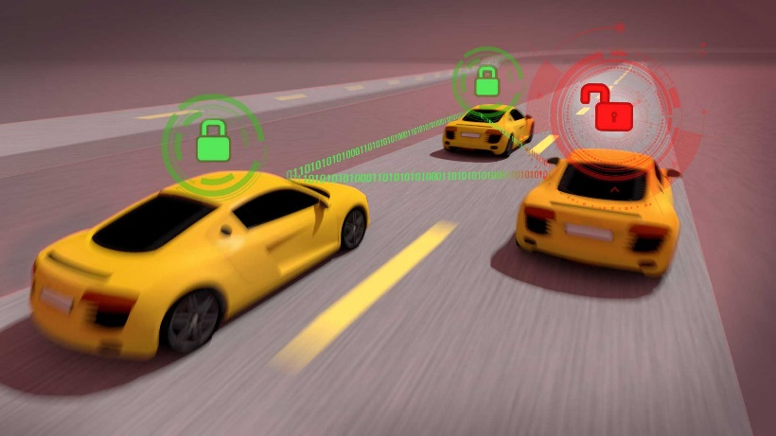
Research Approach Security
Safe and efficient Dynamic Module
Safe intelligent dynamic module
Not only functional safety
But security with data
Embedded Security
Bus Systems Security
Internal security of MCU
Hardware-software solution to increase Data security: i.e. Aurix 2G mit CycurHSM in dynamic module
Data transmission
Data Security
Data access
Source: Automotive iQ
Source: Michigan Engineering

Slide 14
Research Approach Research challenges
Challenges in development of safe and highly efficient dynamic module
Failure detection Ultrahigh frequency monitoring
Fail-operational
Strong limited failure: keep system in safe state ASIL B / C
Limited failure i.e. limp home
No limited failure: quick reaction and increasing of redundancy Additional Safety Unit
Safe State = Functional Safety and Embedded Security
Embedded Security Hardware-Software combined solutions

Slide 15
Agenda
Curriculum Vitae
Background
Development of safe and highly efficient dynamic module
Research Approach
Work Progress
Outlook
Financing

Slide 16
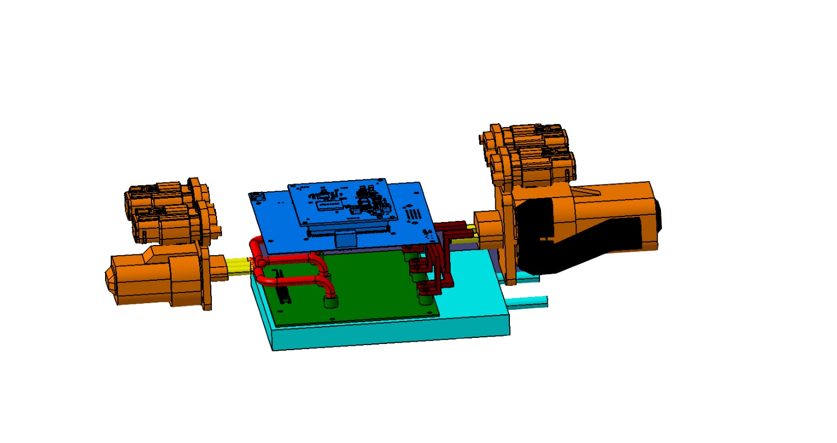
Work Progress Work progress
Safe and efficient Dynamic Module
First version of dynamic module has been already developed
Standard monitoring are used in first version
Seminar of functional safety
Functional Safety on system level (extern of dynamic module) defined → prediction

Slide 17
Agenda
Curriculum Vitae
Background
Development of safe and highly efficient dynamic module
Research Approach
Work Progress
Outlook
Financing

Slide 18
Electronics Department Li, Minglu
Profile – Ph.D. Activities
Li, Minglu
M.Sc. RWTH Aachen University
Status
Executive Summary
induction phase
definition phase
focusing phase
scientific investigation
finalization phase
Current automated driving EVs are still on the field of traditional mechanical control systems. Highly automated driving EVs with steer-by-wire system shall be the trend for the future. At the same time safety plays a much more significant role than present design.
Efficient control process or energy saving is becoming much more popular since the reach of EVs is still limited.
Since data protection becomes more and more often in our daily life. Our automated driving EVs shall be safer than ever. This addresses component safety and IT safety simultaneously. Embedded security is the lowest level of data security which is directly relevant to our hardware and low level software.
Next Actions
Research of ultrahigh frequency monitoring
First FMEDA analysis for present dynamic module
Research of safety unit
Research Assistant
Notes and Ideas
Increasing current monitoring frequency
Standardization peripherals with ISO26262 ASIL Level of Aurix Control unit

Slide 19
Agenda
Curriculum Vitae
Background
Development of safe and highly efficient dynamic module
Research Approach and Measure
Work Progress
Outlook
Financing

Slide 20
Financing Financing
Safe and efficient Dynamic Module
Publicly funded project by BMBF: UNICARagil
Dynamic module of UNICARagil could be further developed and optimized
The test platform of dynamic module could be used to test and prove the ideas and designs
Other E / E safety, efficiency and security relevant projects

Slide 21
Minglu Li, M.Sc.
+49 241 80 25702
+49 241 80 22147
Minglu.li@ika.rwth-aachen.de

Slide 22
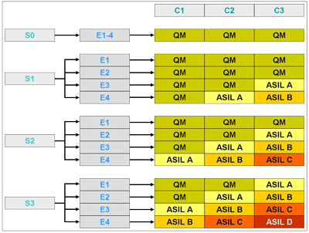
Backup ASIL Level
Safe and efficient Dynamic Module
S: Severity
E: Exposure
C: Controllability
ASIL B =
S3 + E4 + C1 or
S3 + E3 + C2 or
S2 + E4 + C2 or
S3 + E2 + C2 or
S2 + E3 + C3 or
S1 + E4 + C1
Source: ISO 26262 - 3

